Slide 1
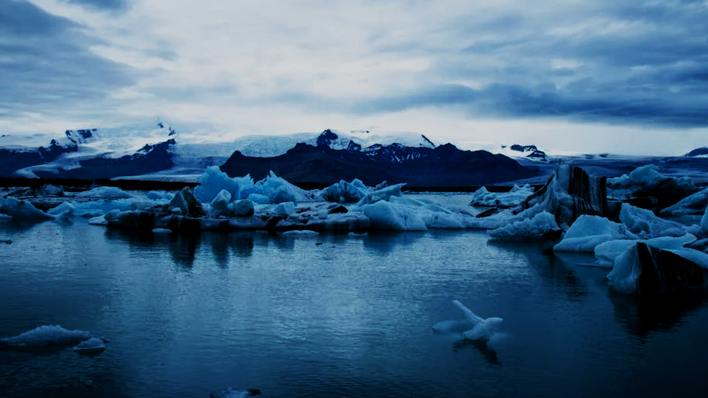
SAYEDA, TIANYI, HANIFE, RAHUL
CLIMATE CHANGE
PRESENTATION
2024/2025

Slide 2
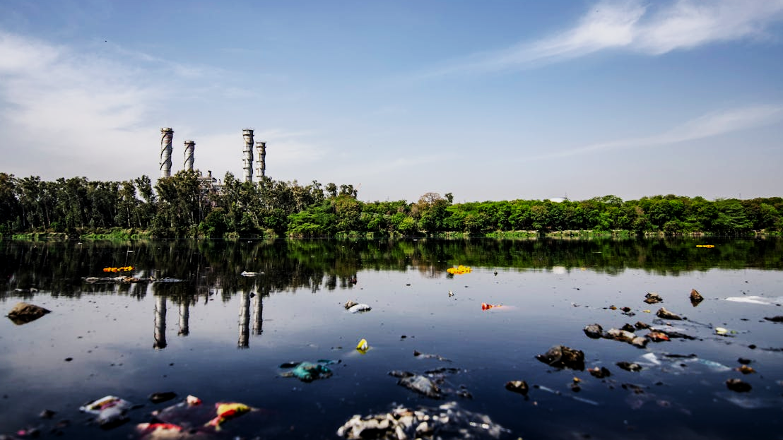
INTRODUCTION
WHAT IS CLIMATE CHANGE?
COUNTRIES WITH FLUCTUATING TEMPERATURES
TRENDS
TEMPERATURE AND SEASONS
ANNEX-NON-ANNEX COUNTRIES

Slide 3
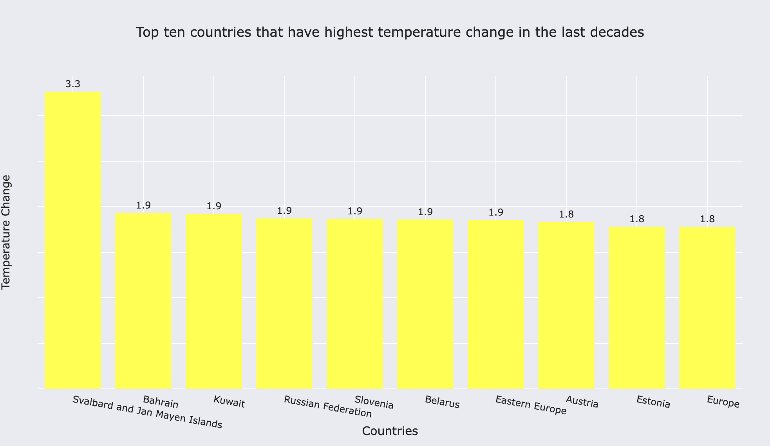
Data Wrangling

Slide 4
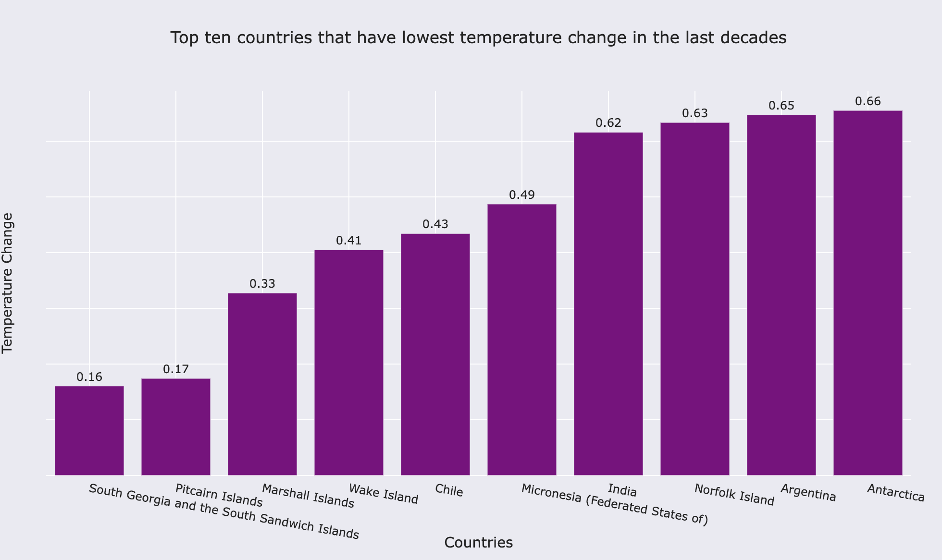

Slide 5
In a nutshell, an analysis of climate change data spanning nearly 80 years from 1961 to 2019 reveals that human activities have significantly altered our climate. The most affected region is Svalbard and Jan Mayen Islands, whereas South Georgia and the South Sandwich Islands have experienced the least impact.

Slide 6
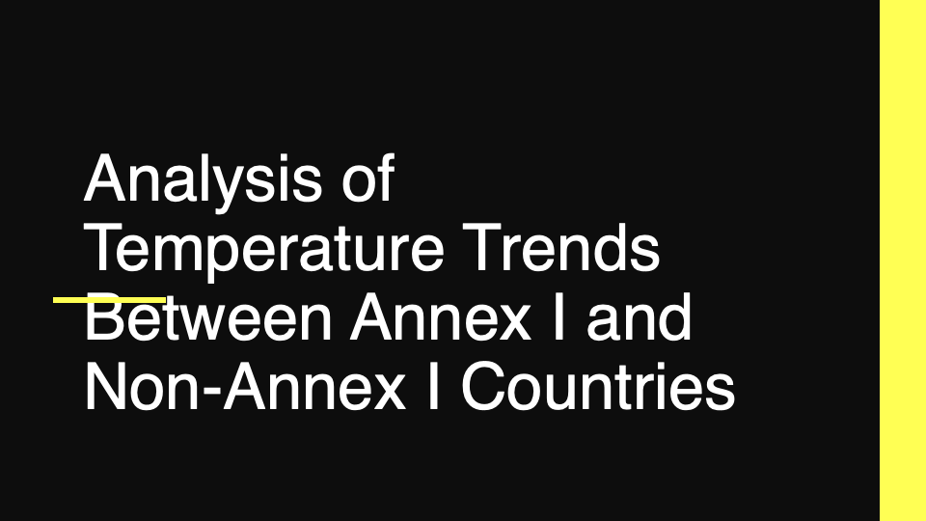
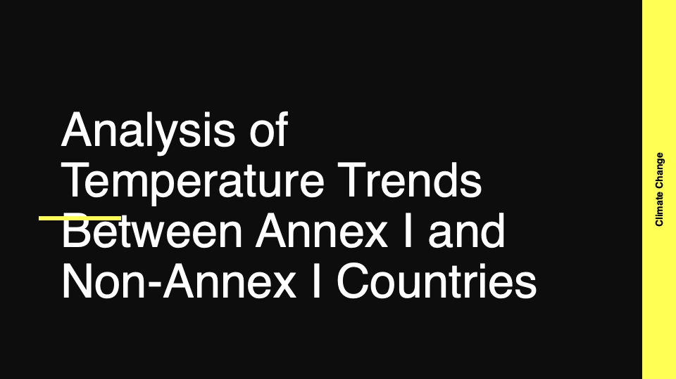
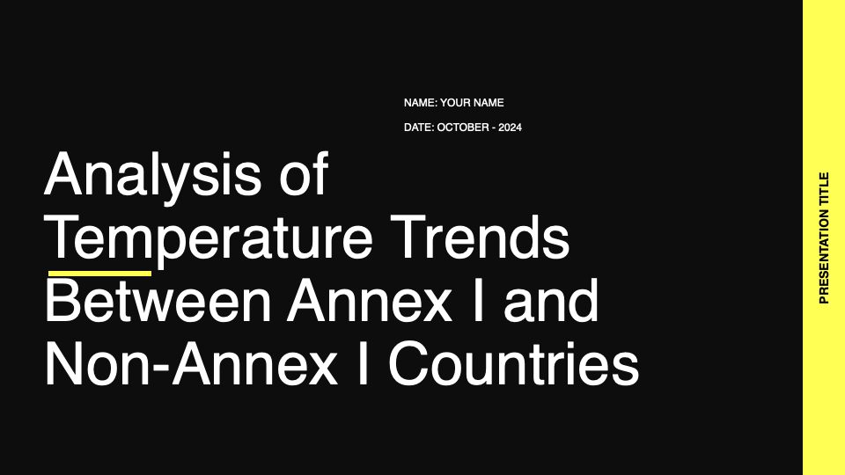

Slide 7
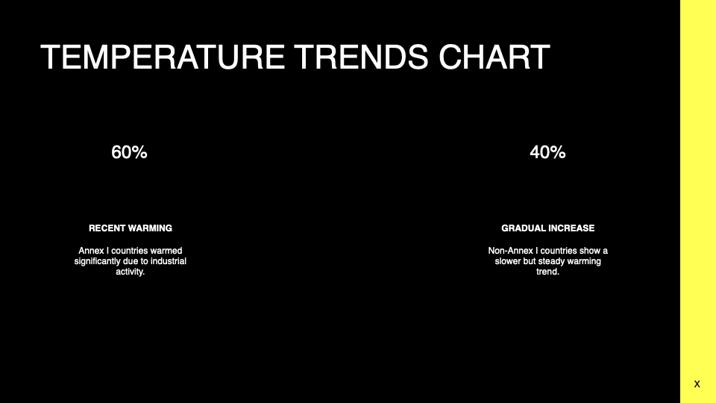

Slide 8
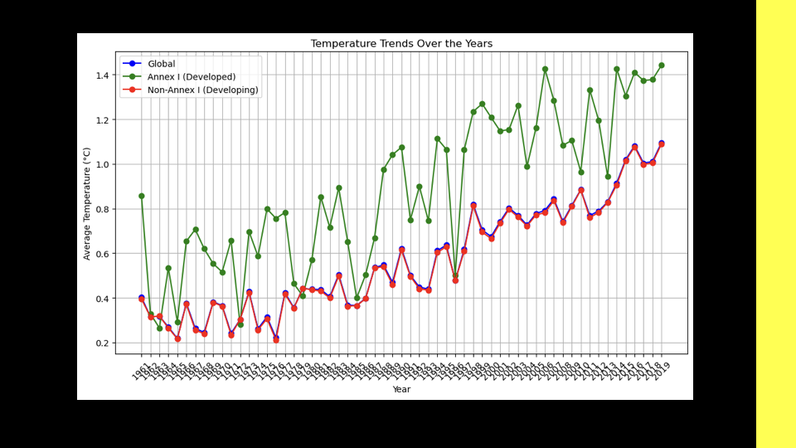

Slide 9
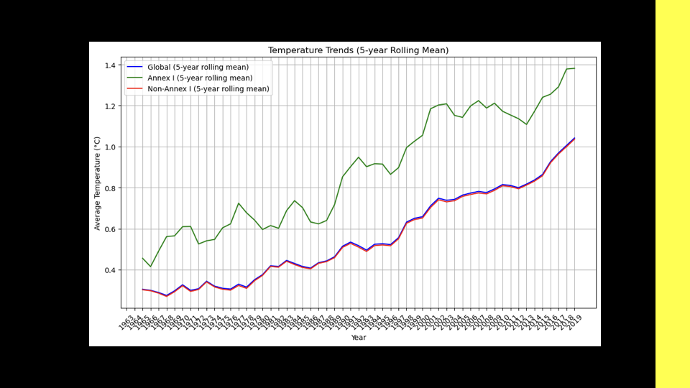

Slide 10
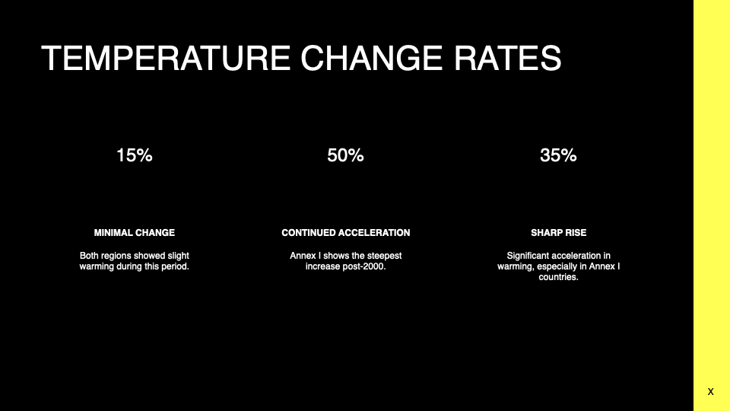

Slide 11
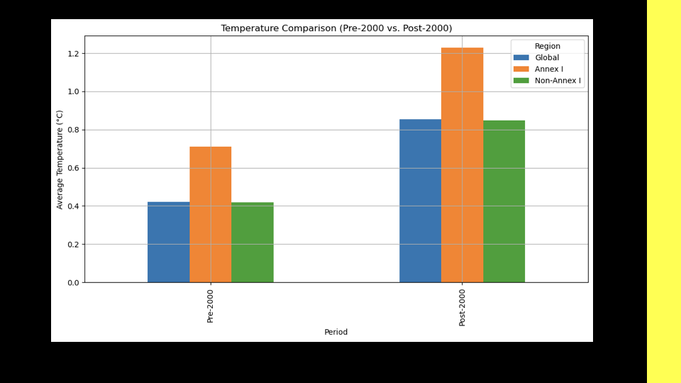

Slide 12
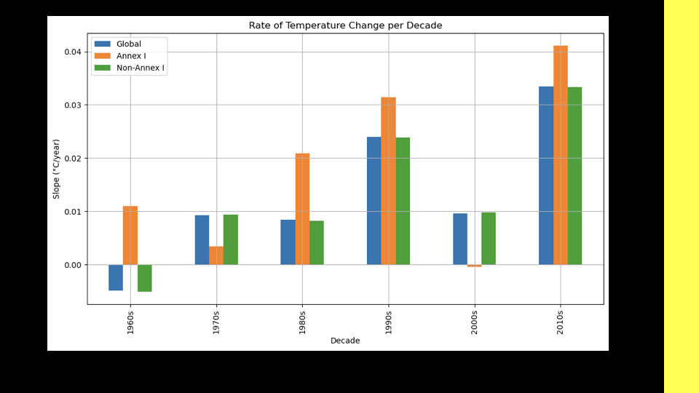

Slide 13
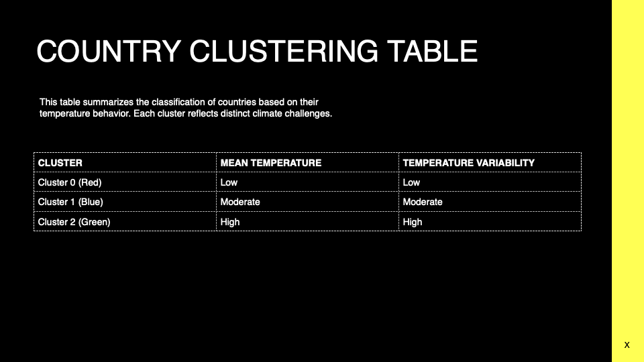

Slide 14
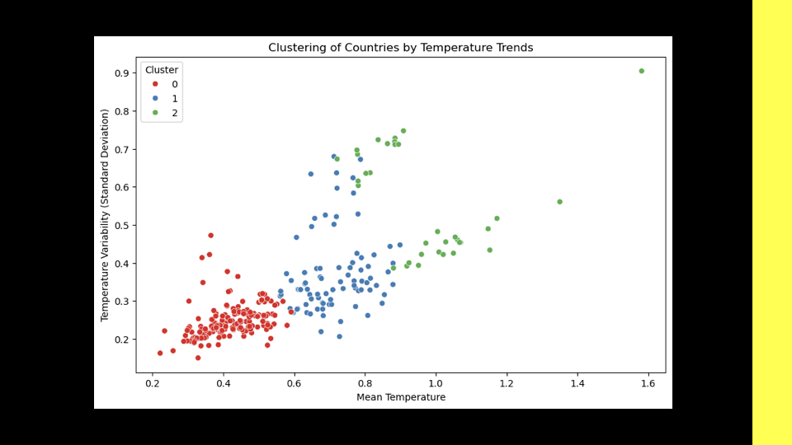

Slide 15
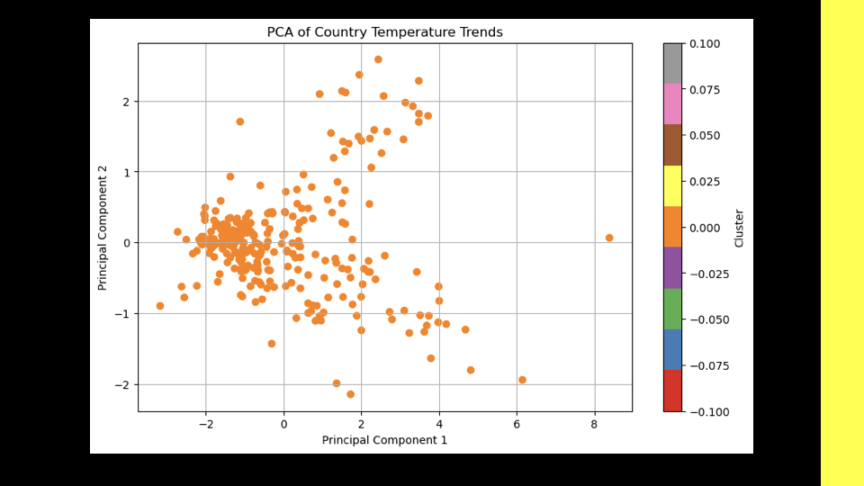

Slide 16
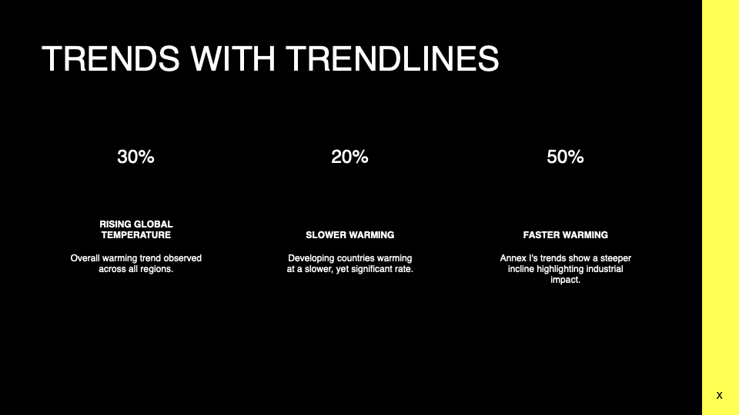

Slide 17
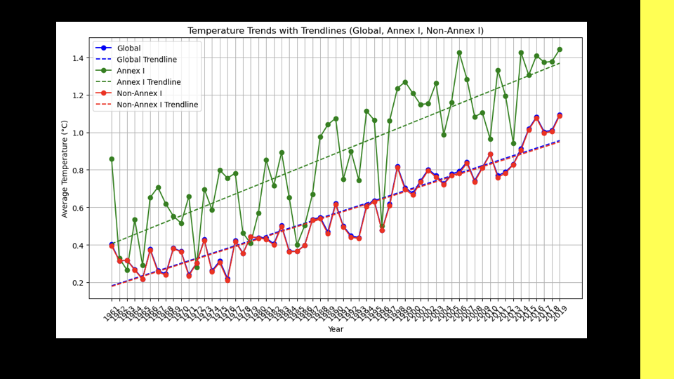

Slide 18
An Overview of Meteorological Value Trends by Country Classification
Country Classifications
World: Global meteorological data.
Annex I Countries: Typically industrialized countries that are part of the UN climate conventions.
Non-Annex I Countries: Developing countries with different environmental and economic profiles

Slide 19
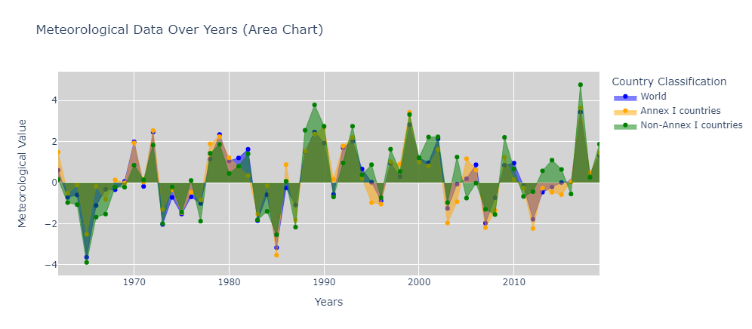
:

Slide 20
Conclusion of Meteorological Value Trends
Meteorological trends are not uniform across the world.
Annex I and Non-Annex I countries experience fluctuations differently.
Notable periods where all categories show similar trends (e.g., between 1990 and 2000).

Slide 21

DATA VISUALIZATION USING A MAP
RELATING TO CLIMATE FLUCTUATING & GLOBAL WARMING
Presenting visualizations (world map) showcasing:
Global temperature changes over time.
By season
Industrialized vs non-industrialized countries

Slide 22
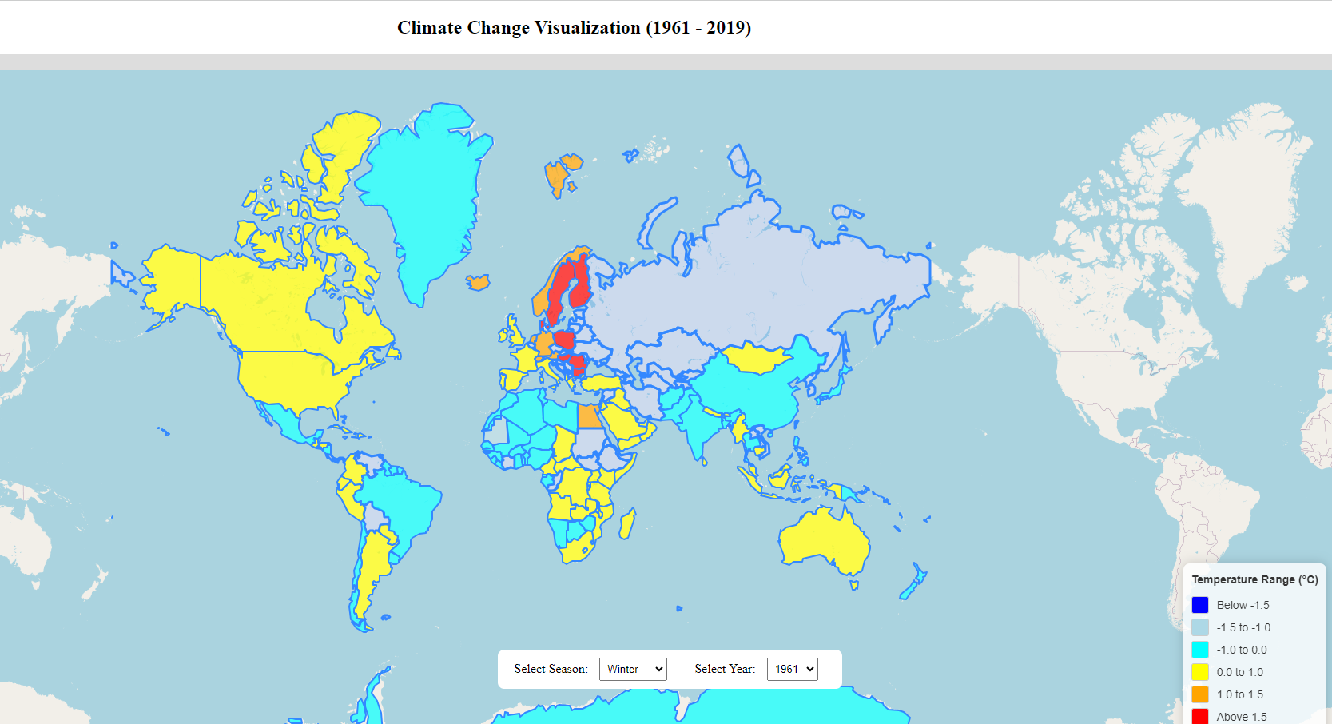
1961 WINTER

Slide 23
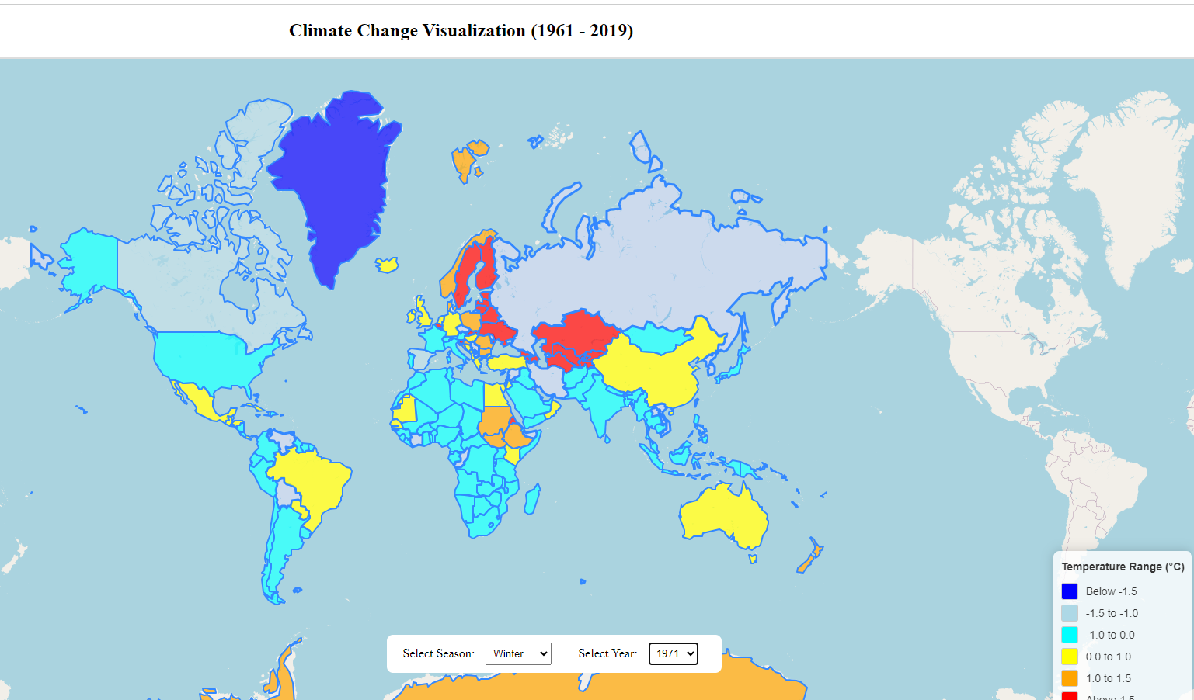
1971 WINTER

Slide 24
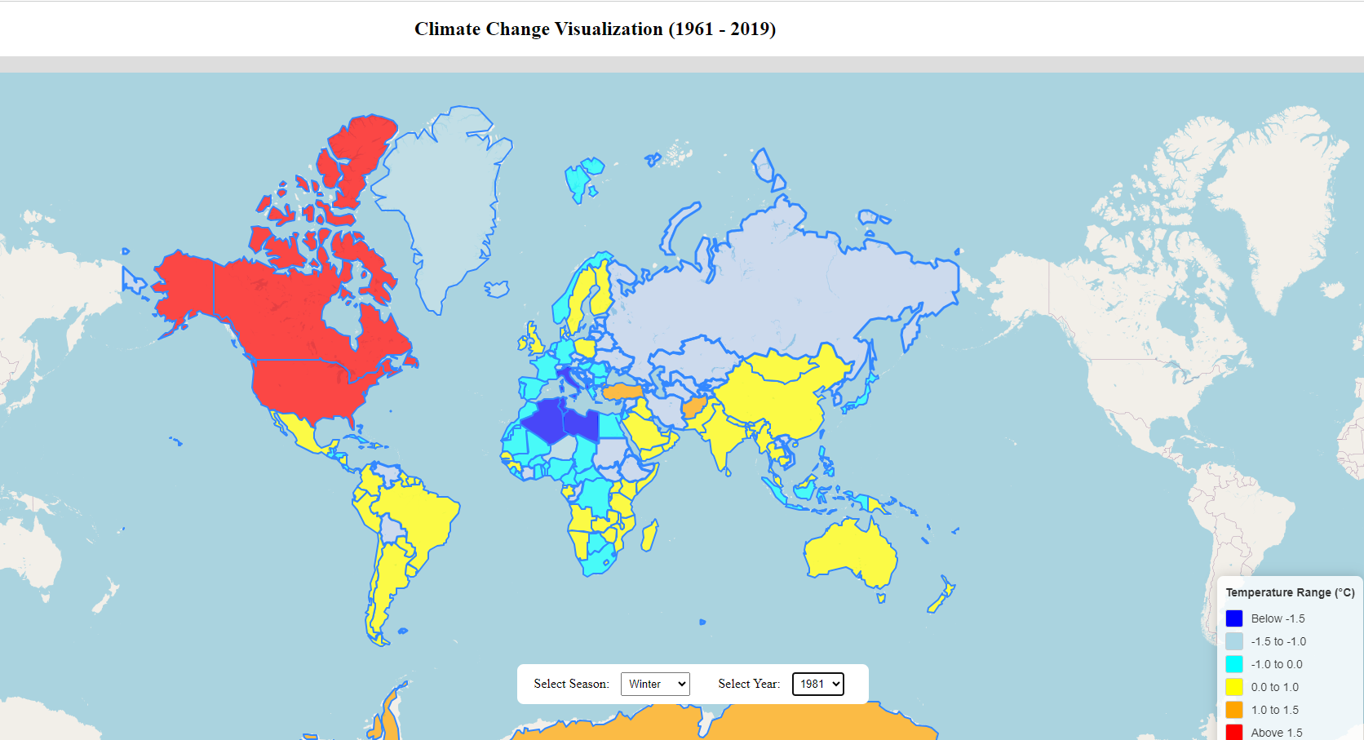
1981 WINTER

Slide 25
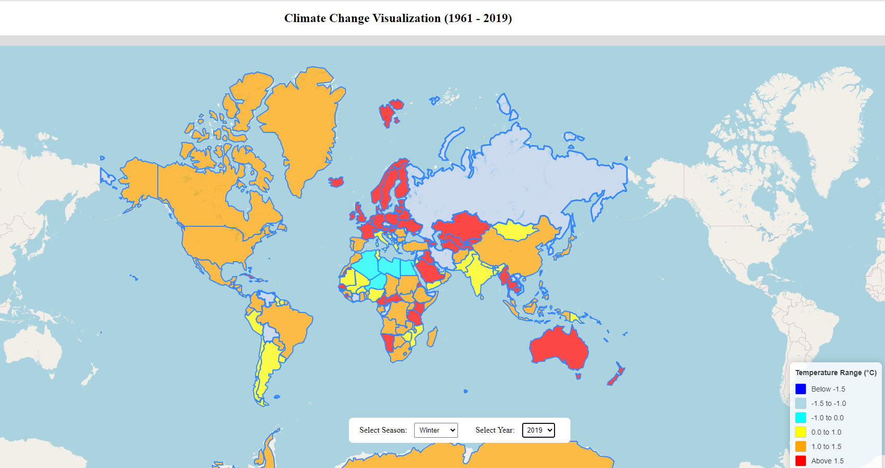
2019 WINTER

Slide 26
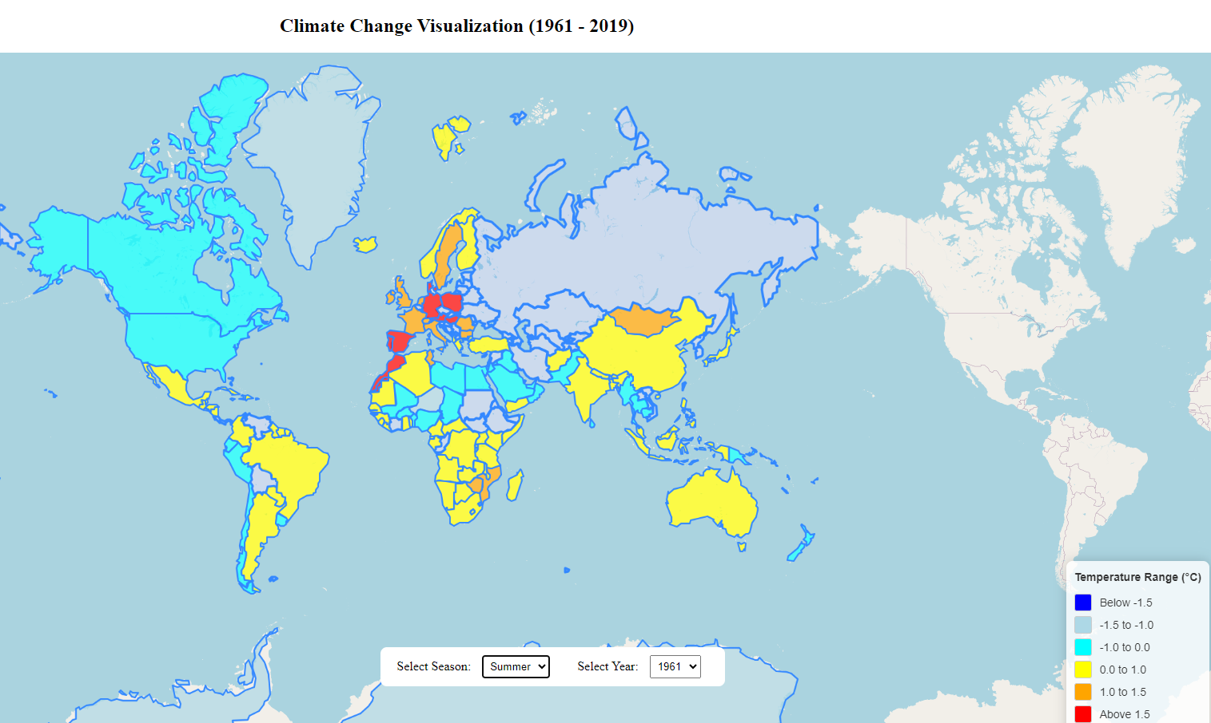
1961 SUMMER

Slide 27
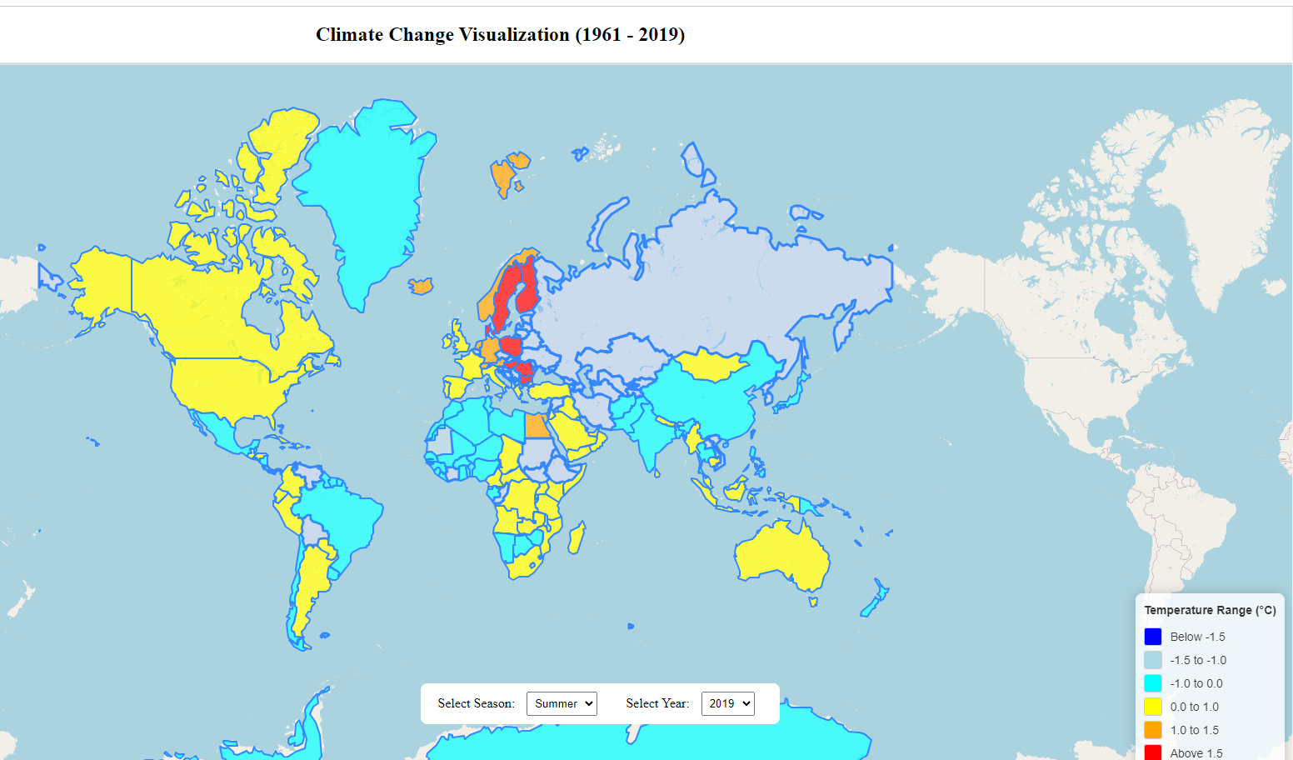
2019 SUMMER

Slide 28
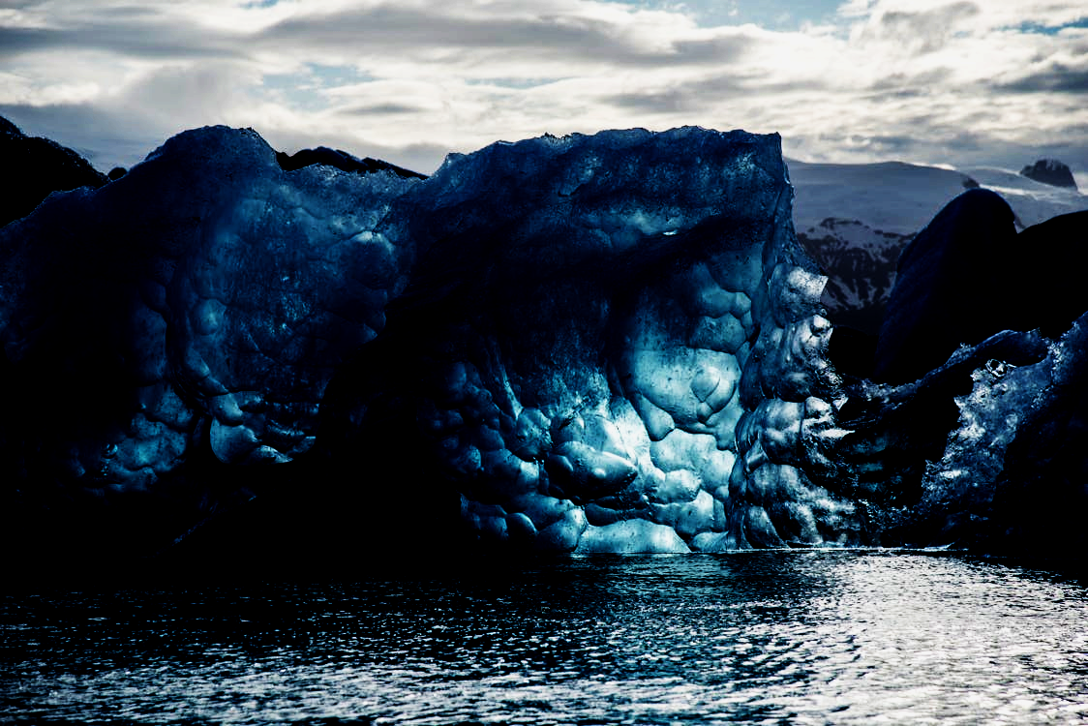
AS YOU CAN SEE FROM THE FOLLOWING GRAPHS, CLIMATE CHANGE IS GETTING WORSE AS THE YEARS GO BY.

Slide 29
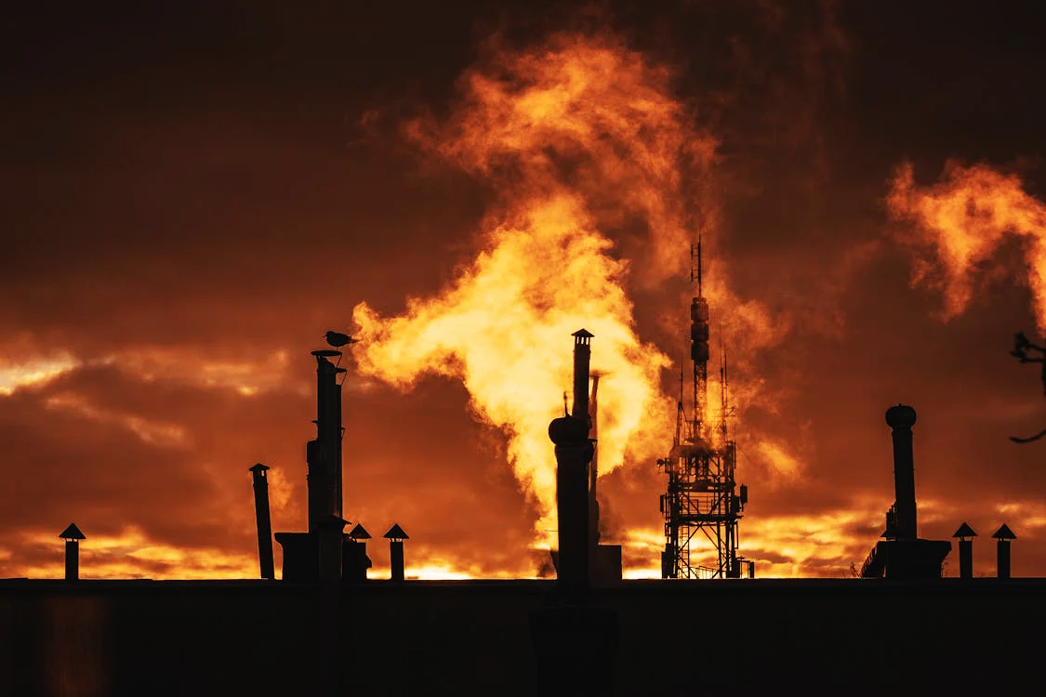
CONCLUSION

